Slide 1

Sentiment Analysis for Student Feedback
TEAM MEMBERS
NANDHANA C.V (2205101)
PAVITHRA K.R (2205107)
SAVEETHA S.S (2205131)
VAMIKA M (2205154)

Slide 2

Introduction
AI in education enhances feedback analysis for insights into teaching and course quality.
Sentiment analysis uses NLP to categorize feedback as positive, neutral, or negative.
Automates large-scale feedback analysis, reducing manual effort.
Improves decision-making for better academic offerings.
Helps enhance the student learning experience through sentiment insights.

Slide 3
Proposed Methodology
Problem Statement:
The proposed solution automates student feedback analysis using AI-driven sentiment analysis to provide insights into course and teaching quality.
Prototype:
NLP-based Sentiment Analysis: Automatically categorizes feedback into positive, neutral, or negative.
Feedback Collection: Feedback from various platforms is processed via AI models.
Automation (UiPath RPA): Automates feedback extraction, analysis, and report generation.
Report Generation: Summarized sentiment insights are provided for administrative decision-making.
Basic entities:
NLP Model: Trained with sentiment keywords.
RPA (UiPath): Manages feedback workflow and reporting.
AI Sentiment Classifier: Processes and categorizes feedback by sentiment.

Slide 4
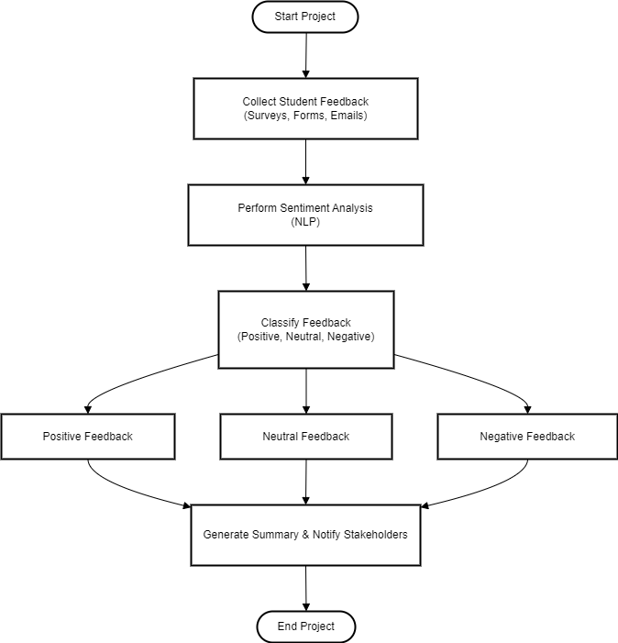
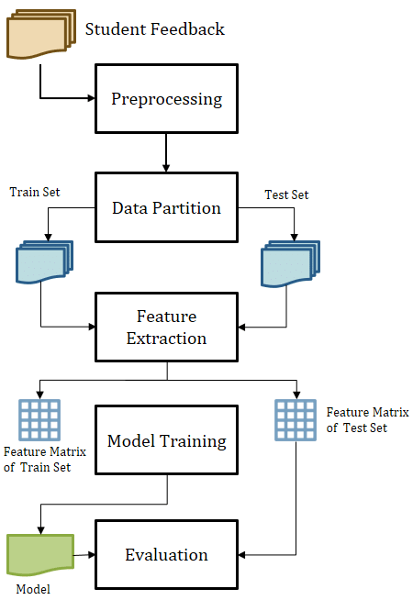
Fig.1 Technical architecture
Fig.2 Workflow

Slide 5
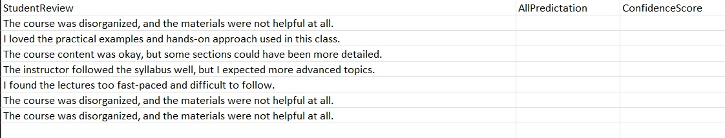
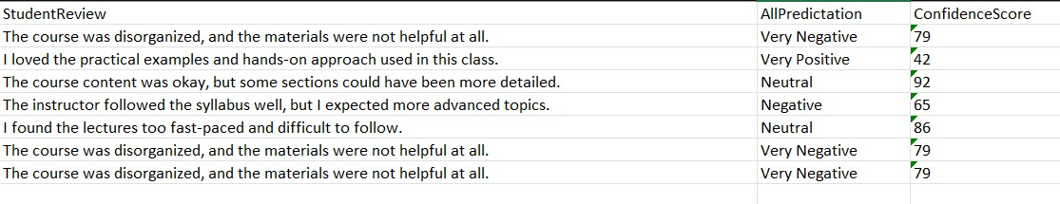
Results
Input:
Output:
Fig.3 Screenshots

